Slide 1
3SL and Cradle
An Overview
RR002/30: June 2019

Slide 2
Contents
  3SL
  Customers
  Example Applications
  Cradle
  Services
  Summary

Slide 3







3SL 1
We are:
  Authors of Cradle requirements management (RM) / systems engineering (SE) tool
  Providers of Cradle-related RM and SE services
Contact:
  Tel: +44 1229 838867
  Fax: +44 1229 870096
  Website: http://www.threesl.com
  E-mail: Sales: salesdetails@threesl.com
  Support: support@threesl.com
  Twitter: threesl follow us:
  Facebook: 3slcradle
  LinkedIn: 3SL page and Cradle group
  Skype: mgw3sl
  Instagram: Cradle3sl
  Xing: 3SL
  Branded.me: 3SL

Slide 4
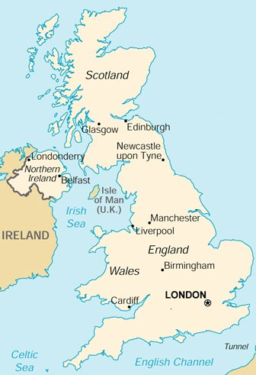
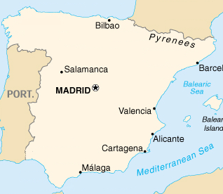
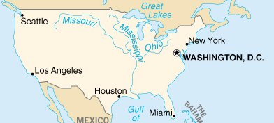
Summary 1.1
UK:
  Founded: 1987
  Offices: Barrow-in-Furness
  Alicante, Spain
US:
  Founded: 1998
  Office: Huntsville, AL
  Houston, TX

Slide 5







Distributors 1.2
Australia: Agile Controls
australia@threesl.com
Benelux/Germany: SOMS Software Tools
germany@threesl.com
Brazil: OpenCADD Advanced Technology
brazil@threesl.com
China: Beijing YeeRich
yeerich@threesl.com
Russia: SATURS
russia@threesl.com
South Korea/China: SNS Engineering
korea@threesl.com
USA: 3SL Inc
sales@us-3sl.com

Slide 6









Accreditations and Affiliations 1.3
  Digital Marketplace
  GSA
  XenApp 7
  CitrixReady
  INCOSE
  MSDN
  Cyber Essentials
  IASME Consortium
  ISO9001: 2015

Slide 7
UK Government Services 1.4
Software as a Service (SaaS) and Specialist Cloud Services (SCS) in G-Cloud 11 framework
Range of SaaS services including one-week project start-up:
  Agile Collaboration: unclassified and OFFICIAL SENSITIVE (IL3)
  Agile Software Development: unclassified and OFFICIAL SENSITIVE (IL3)
  Agile Software Management: unclassified and OFFICIAL SENSITIVE (IL3)
  Application Lifecycle Development: unclassified and OFFICIAL SENSITIVE (IL3)
  Application Lifecycle Management: unclassified and OFFICIAL SENSITIVE (IL3)
  Business Analysis: unclassified and OFFICIAL SENSITIVE (IL3)
  Business Process Modelling: unclassified and OFFICIAL SENSITIVE (IL3)
  Requirements Management: unclassified and OFFICIAL SENSITIVE (IL3)
  Systems Engineering: unclassified and OFFICIAL SENSITIVE (IL3)
See full SaaS service listings here

Slide 8
Customers 2
Markets (alphabetical order):
  Academic
  Aerospace and Defence
  Automotive
  Banking and Finance
  Consultancy, IT, Systems Integration
  Energy and Construction
  Government and Military
  Manufacturing
  Medical and Pharmaceutical
  Telecommunications
  Transport
Over 275 customers (many with multiple Cradle systems)
Over 12,000 Cradle licences

Slide 9


























Academic 2.1

Slide 10























Aerospace and Defence 2.2

Slide 11
















Aerospace and Defence: 2

Slide 12








Automotive 2.3

Slide 13


Banking and Finance 2.4

Slide 14


























Consultancy, IT, Systems Integration 2.5

Slide 15























Consultancy, IT, Systems Integration: 2

Slide 16





























Energy and Construction 2.6

Slide 17
















Government and Military 2.7

Slide 18


























Manufacturing 2.8

Slide 19











Medical and Pharmaceutical 2.9

Slide 20









Telecommunications 2.10

Slide 21










Transport 2.11

Slide 22











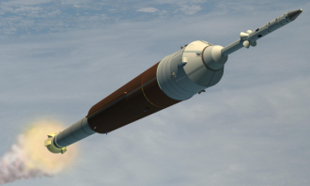


















Example Applications 3
Automotive
Space Systems
Operations
EVA / CSSS
Taurus II
Safety & Controls
Consoles
Lighting
Engine
Management
Orion
SLS, Ares V, Altair
COTS
Space
Communications
Naval
Astute
Submarine
CVF / QEC
Type 45
CVN77
CVNX
CVN-21
Aviation
Tornado
GR4
Communications
Construction
Harrier
GR7/9
E-2C
Typhoon
F-22
F-35
G3/4/5 Cellular Networks
Radios
Nuclear
Nimrod MRA4
Air-to-Air Refuelling
A400M / KC-46
Roads/Bridges
Air Traffic Control

Slide 23
Cradle 4
Integrated, multi-user, systems engineering environment, for:
  Requirements management • System, architecture, performance modelling
  Document generation • Software-design synchronisation
  User defined environments • Web publishing
  Web access (portals) • Distributed data management
Major release each year, typically 2-3 interim releases per year
Consider:
  Lifecycle Coverage
  Scope
  Architecture
  SaaS deployment
  In-house deployment
  Interfaces
  Processes

Slide 24
Lifecycle Coverage 4.1
Cradle supports the full lifecycle, providing end-to-end traceability:
Issue Management
Traceability / Coverage
Documentation
Interface Management
Metrics
Risk Management
CM
Access Control
Cradle
Requirements
Acceptance
Analysis
Validation
Systems
Engineering
Architecture
Integration Test
Design
Verification
Discipline
Point
Tools
Engineering Disciplines
Mechanical,
Electrical,
Electronic,
Civil,
Software
Detailed Design
Module Test
Implementation
Unit Test

Slide 25
Lifecycle Coverage: 2
Both at multiple levels:
and in phased or
agile processes:
Analysis
Release
System level
Subsystem level
Component level
.. other levels
Requirements
Acceptance
Architecture
Validation
Analysis
Integration
Design
Verification
Release
Requirements
Implementation
Acceptance
Architecture
Validation
Analysis
Integration
Design
Verification
Release
Requirements
Implementation
Acceptance
Architecture
Validation
Design
Integration
Verification
Implementation
Features
Updates
Specify
Needs
Systems
Analysis
Release
Confirm
Requirements
Acceptance
Architecture
Validation
Design
Integration
Verification
Implementation
Build

Slide 26
Scope 4.2
  Capture and manage requirements, assumptions, justifications…
  Create models of use cases, functions, classes, data relationships
  Build system-of-systems, system or subsystem architectures
  Identify and manage system / subsystem interfaces
  Allocate functions to subsystems and equipments
  Define performance, AR&M (Availability, Reliability, Maintainability) and effectiveness
  Manage System, Product, Work and Cost Breakdown Structures (SBSs, PBSs, WBSs and CBSs) and link to project data
  Perform test management at all levels
  Automate project documentation
  Create traceability across the entire lifecycle
  Collect metrics across the entire lifecycle
  Configuration manage and control the project
  Track all formal changes and/or individual edits
  Management information from dashboards, KPIs, burn-down / earned-value charts
  Integrate with desktop and specialist tools
  Provide customised web environments to project groups

Slide 27
Architecture 4.3
Cradle manages information in projects:
  Each in a project database (PDB)
  With a user-defined structure (schema)
  Using a client-server architecture:
  And custom web UIs
Industrial strength:
  Multi-user (8,192)
  Multi-project
  Distributed
  Open
  Extensible
  Scalable and fast
Browser
Browser
Tools
Servers
External
Tools
External
Tools
External
Tools
Word
Project Databases
(DISAM, Oracle, MySQL)
Excel
Visio
Project

Slide 28
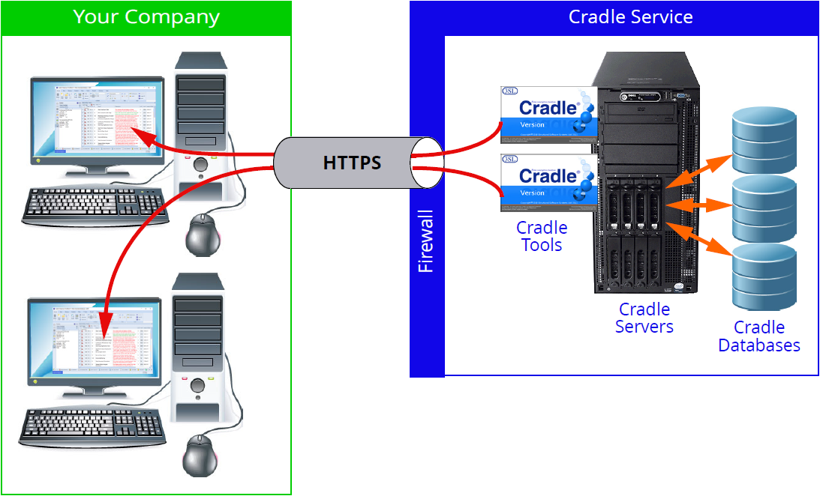
SaaS Deployment 4.4
Rapid deployment on remote servers, no demands on your IT
Flexible, you choose:
  Cradle system
  Number of users
  Term
  Environment:
    Shared
    Dedicated
Secure:
  Firewall
  Only your IPs
  Only your users
  Single HTTPS link
Managed by 3SL:
  Resilient
  Backed-up
  Includes MS Office
Your data is private to you in
both shared and dedicated
environments. 3SL has no
access to your data.

Slide 29
In-House Deployment 4.5
Single-user and multi-user products. Same software. Configured by Security Code.
Multi-user Cradle Enterprise is licensed in modules
You choose how many concurrent user licences are needed of each module:
  Project Data Management: PDM
  Requirements Management: REQ
  Metrics: MET
  Dashboard: DASH
  System Modelling: SYS (contains 3 sets of notations)
  Performance Modelling: PERF
  Document Generator: DOC
  Web Publishing: WEBP
  Web Access: WEBA
  Software Engineering: SWE
Licences:
  Floating and dynamic - Maximise sharing
  Open or named user - Cost effective
  Low cost RO licences - Customer/subcontractor browsing
Share smallest number of licences between greatest number of users

Slide 30
Interfaces 4.6
Project
Word
WSI
Teamwork
Select
BPwin
CORE
Publishing
Parsing &
Capture
REST-based
HTTP requests
Models
RDD-100
WBS
Progress
Models and
Requirements
Data
Converters
Active Risk
Manager
API
Cradle
Import/
Export
Cradle, CSV, ReqIF
HTML, XML
Function
Specifications
Frames
Para/Table
Capture
JIRA
Documentum
Word
Bugzilla
Cmd
Reporting
Spreadsheet
Capture
Others (URL refs)
Report Generation
Diagram Printing
Document Publishing
Excel
Report
Generation
PDF
Visio
PDM/PCLM Tools
Excel
CSV
HTML
Word

Slide 31
Processes 4.7
Cradle supports industry processes:
  EIA 632
  P1220
  ISO 15288
  Company-specific
Commercial processes:
  Reveal
  Volere
Governmental processes and process frameworks:
  UPDM, TOGAF
  PRINCE2
Cradle's UI is configurable to support project's processes:
  User-defined hierarchy of folders/subfolders for process phases, activities, reviews
  User-defined methods of accessing project data, such as iterations in:
    Agile processes
    SCRUM
    Rational Unified Process (RUP)

Slide 32
Services 5
Successful deployment of any RM / SE tool depends on:
  Defined process
  Skilled personnel
  Training
  Consultancy
3SL and our partners can support any/all of these aspects
Services:
  Deployment – both SaaS and in-house
  Support
  Training
  Consultancy
  Web delivery

Slide 33
Support 5.1
Maintenance agreement provides free:
  New releases (up to 3 times / year)
  Helpdesk – unlimited technical support
  Newsletters
Support teams in:
  UK • US
  Australia • Brazil
  China • Europe
  Russia • South Korea
Helpdesk call tracking system:
  Log and view call progress through 3SL website
  Central calls database accessible by 3SL support team
  Prompt logging of, response to, tracking of, support calls
  Customised reports prepared on request

Slide 34
Training 5.2
Training course:
  Tailored set of 1 hour modules – documented in Course Plan
  Given on-site, can be delivered remotely
  Includes hands-on exercises
  Ideally a PC per 1 or 2 students
  Free Cradle licences for training courses
Typical courses:
  Overview - 1 day
  Cradle Users Course - 3 days
  Requirements Management - 2 days
  System Modelling - 2 days
  Document Generation - 2 days
  Cradle Administrators - 2 days
  IT Administrators - 1 day

Slide 35
Consultancy 5.3
Options:
  1 Week Project Initiation and Start-up:
    Process analysis
    Schema design and implementation
    Documentation template design
  Project Mentoring:
    Process guidance
    Project Requirements Reviews
    Project Design Reviews
  Project Resourcing:
    Provide engineers to project:
      Tool expertise
      RM / SE experience
      Domain experience
    To smooth resource peaks / throughout project

Slide 36
Web Delivery 5.4
3SL delivers many of its services through our website including:
  Software and documentation downloads
  Logging of support calls
  Online records of your support calls, updated daily
  Individual customer accounts on website’s FTP
  Automated Security Codes for evaluations and trials of new software releases
3SL delivers these services over HTTPS
  Fully accredited and certified
Ensures secure communications between you and 3SL:
  Safeguarding any information that we exchange
  Ensuring your privacy

Slide 37
Summary 6
  3SL is a well established supplier of SE and RM tools
  Cradle has tools to support the needs of modern RM / SE projects
  Totally reliable and industrially proven
  Power and scalability to support any project
  Supported by flexible, tailored, training
  Supported by flexible consultancy support
From concept to creation …
… from Cradle to grave
Build the winning team – you, Cradle and 3SL!

